Slide 1
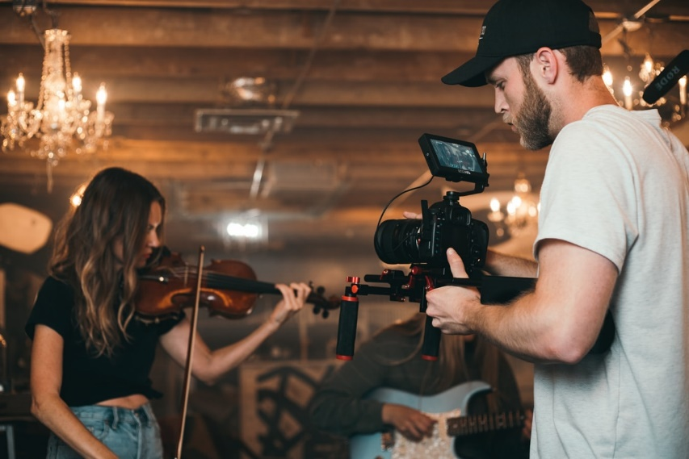
Dell Conversation Class
Christopher bAUMAN

Slide 2
Education Infographic
Editing
Props
Director
Producer
Cast
Actor / Actress
Action
Cut
That’s a rap
Makeup
Scene
Location
Time
Costumes
Extras
Script
Record
Motivation
Difficulties
Teachers
Education
Skills
Chris Bauman

